Slide 1

Automated Essay Scoring
Tarun kumar – 2022201008
VAIBHAV MITTAL – 2022201016
Varun Vashishtha - 2022201061

Slide 2
PROBLEM DESCRIPTION
AES involves the use of computer algorithms to evaluate and score written essays.
Importance of AES in educational assessment Efficiency:
Faster grading process compared to manual methods.
Consistency: Reduction in subjective biases.
Scalability: Ability to process a large number of essays.

Slide 3
PURPOSE OF AES
It is a time saving approach for educators and institutions.
Ability to handle large volume of essays, especially in standardized testing.
Traditional manual grading has subjectivity and time constraints.
Improved grading consistency and objectivity.
Enhanced feedback for students.

Slide 4
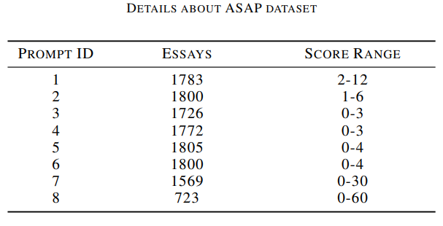
DATASET OVERVIEW
ASAP dataset is used for AES. It composed of 8 prompts and 12976 essays, which are written by students from Grade 7 to Grade 10.

Slide 5
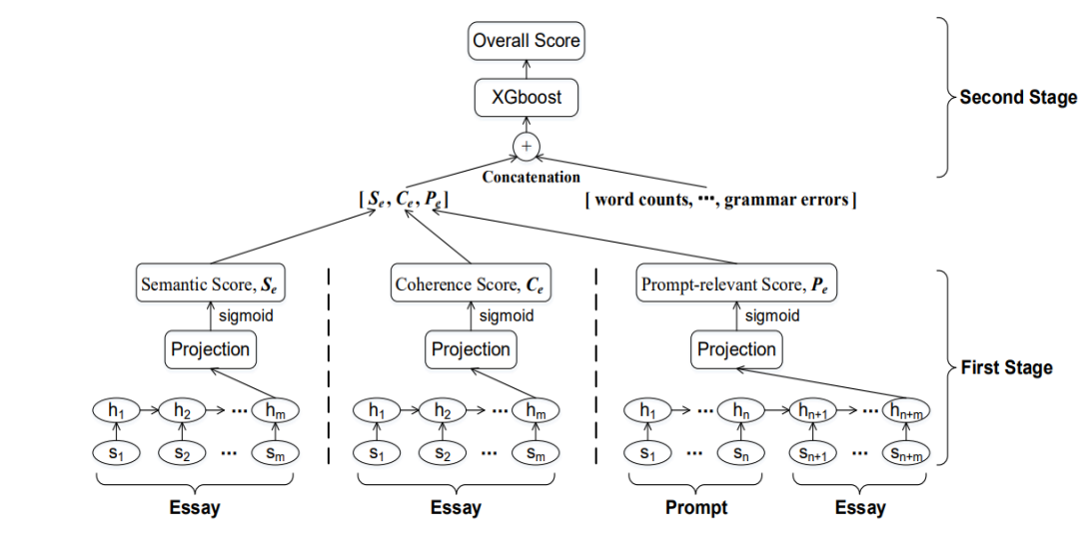
PROPOSED ARCHITECTURE

Slide 6
IMPLEMENTATION OVERVIEW
Feature engineered models
Word Count
Character count
Mean length
Variance score
Grammatical Score

Slide 7
IMPLEMENTATION OVERVIEW
END-To-END Models
Semantic model
Coherence model
Prompt Relevance model

Slide 8
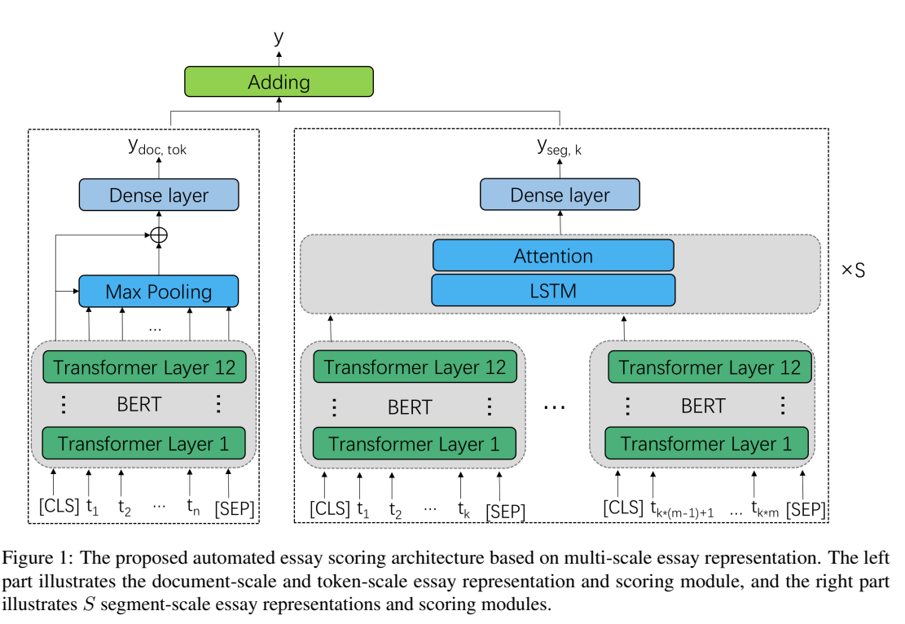
NOVELITY
Multiscale semantic score
Natural language inference for coherence score

Slide 9
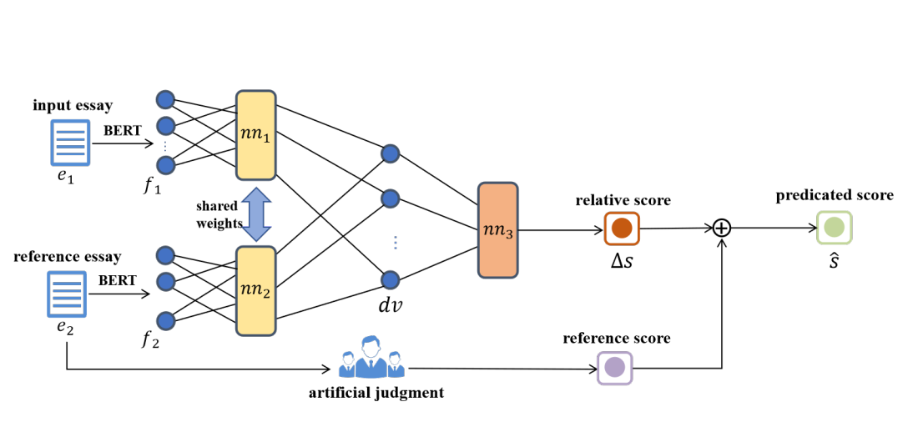
NOVELITY
Pairwise contrastive regression model

Slide 10
EVALUATION METRICS
Quadritic weighted Kappa
Pearson’s Rank Correlation
Spearman’s Rank Correlation
Kendall’s Tau

Slide 11
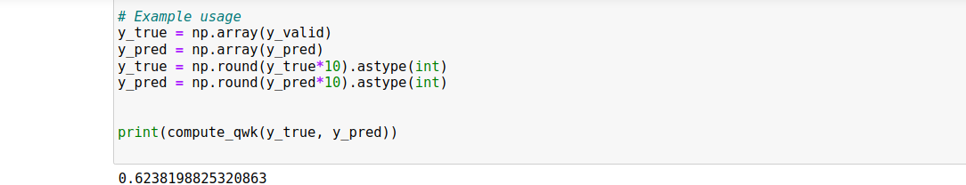
RESULT
QWK score

Slide 12
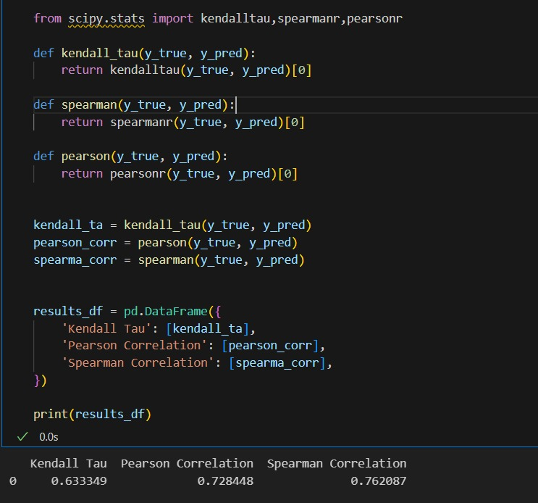
RESULTS

Slide 13
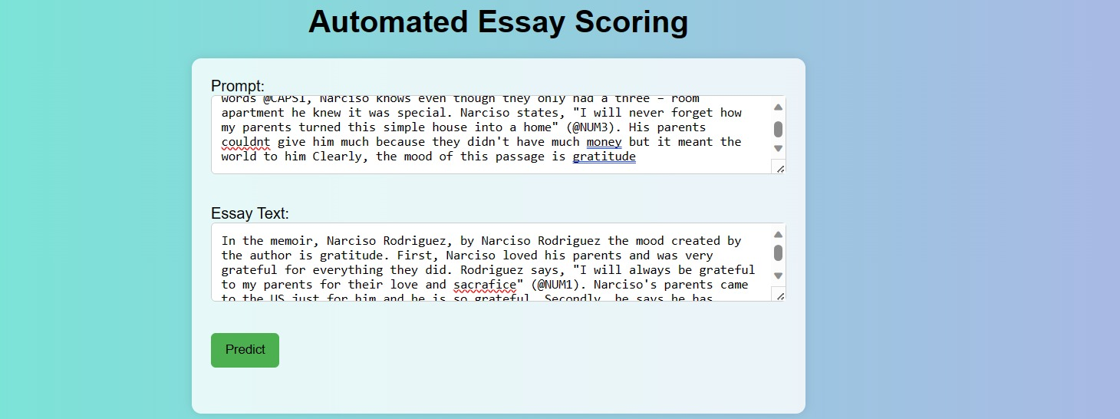
Website Created

Slide 14
Challenges in project
We have faced the following challenges during the implementation of baseline:
Large Dataset Sizes: Training AES models often requires substantial amounts of training data, and processing large datasets can be time-consuming.
Model Complexity: Due to the architecture and depth of the model, the training and scoring processes can be computationally intensive, leading to longer processing times. It is computationally expensive as we are making embeddings of each word and sentence in an essay.
For each model, we have to create separate dataframes, which is a time consuming task.

Slide 15
THANK YOU

